Slide 1

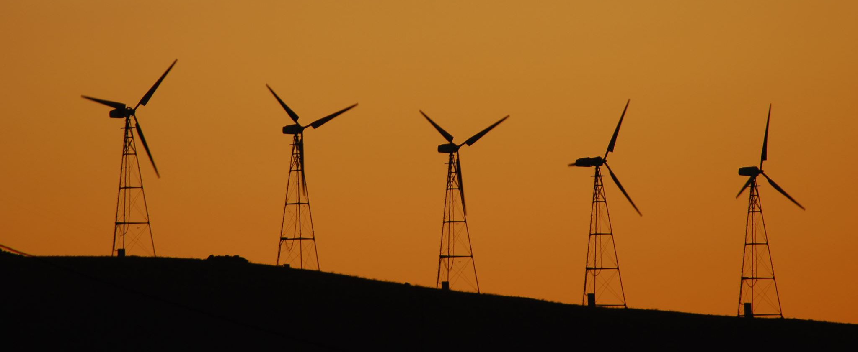
Peak Energy – Demand Optimization
Group 4:
Eric Lee, Jade Matrone, Jeet Bardapurkar, Nithish Kumar, Sandeep Parmar

Slide 2




PROBLEM
2
Global Warming
USABILITY
eSC is worried that next summer will put too much demand on their electrical grid causing blackouts
Build out capability to deliver more energy to clients ie a new energy plant
CUSTOMERS
COSTS
eSC provides electricity to residential properties in South Carolina and a small part North Carolina
Make recommendations for eSC to encourage their customers to save energy

Slide 3
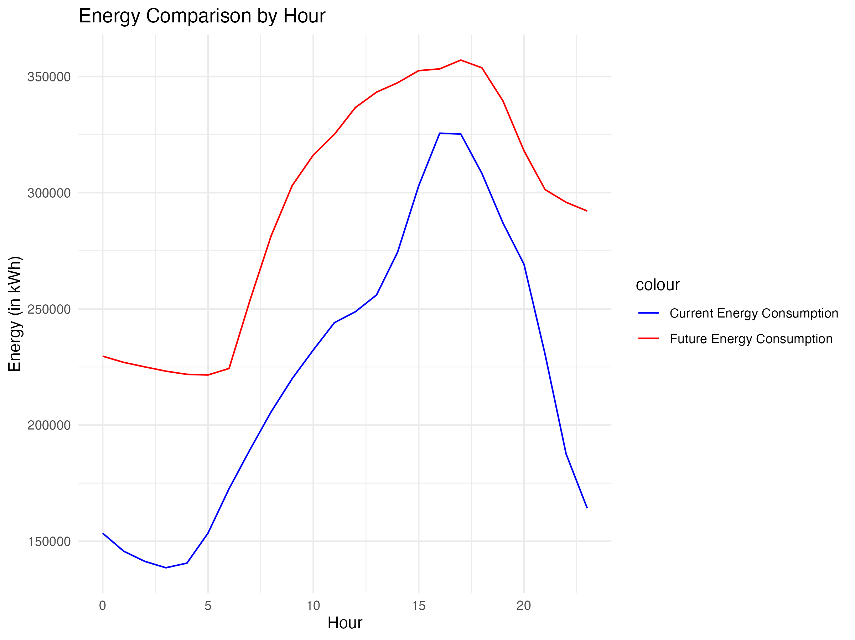
Current vs Forecast
THERE IS
32% INCREASE
IN ENERGY
CONSUMPTION

Slide 4
Reduce Peak Energy Usage
Survey on
plug-load usage
Reduce energy usage during the hours of 3-7PM
LED education and giveaways

Slide 5
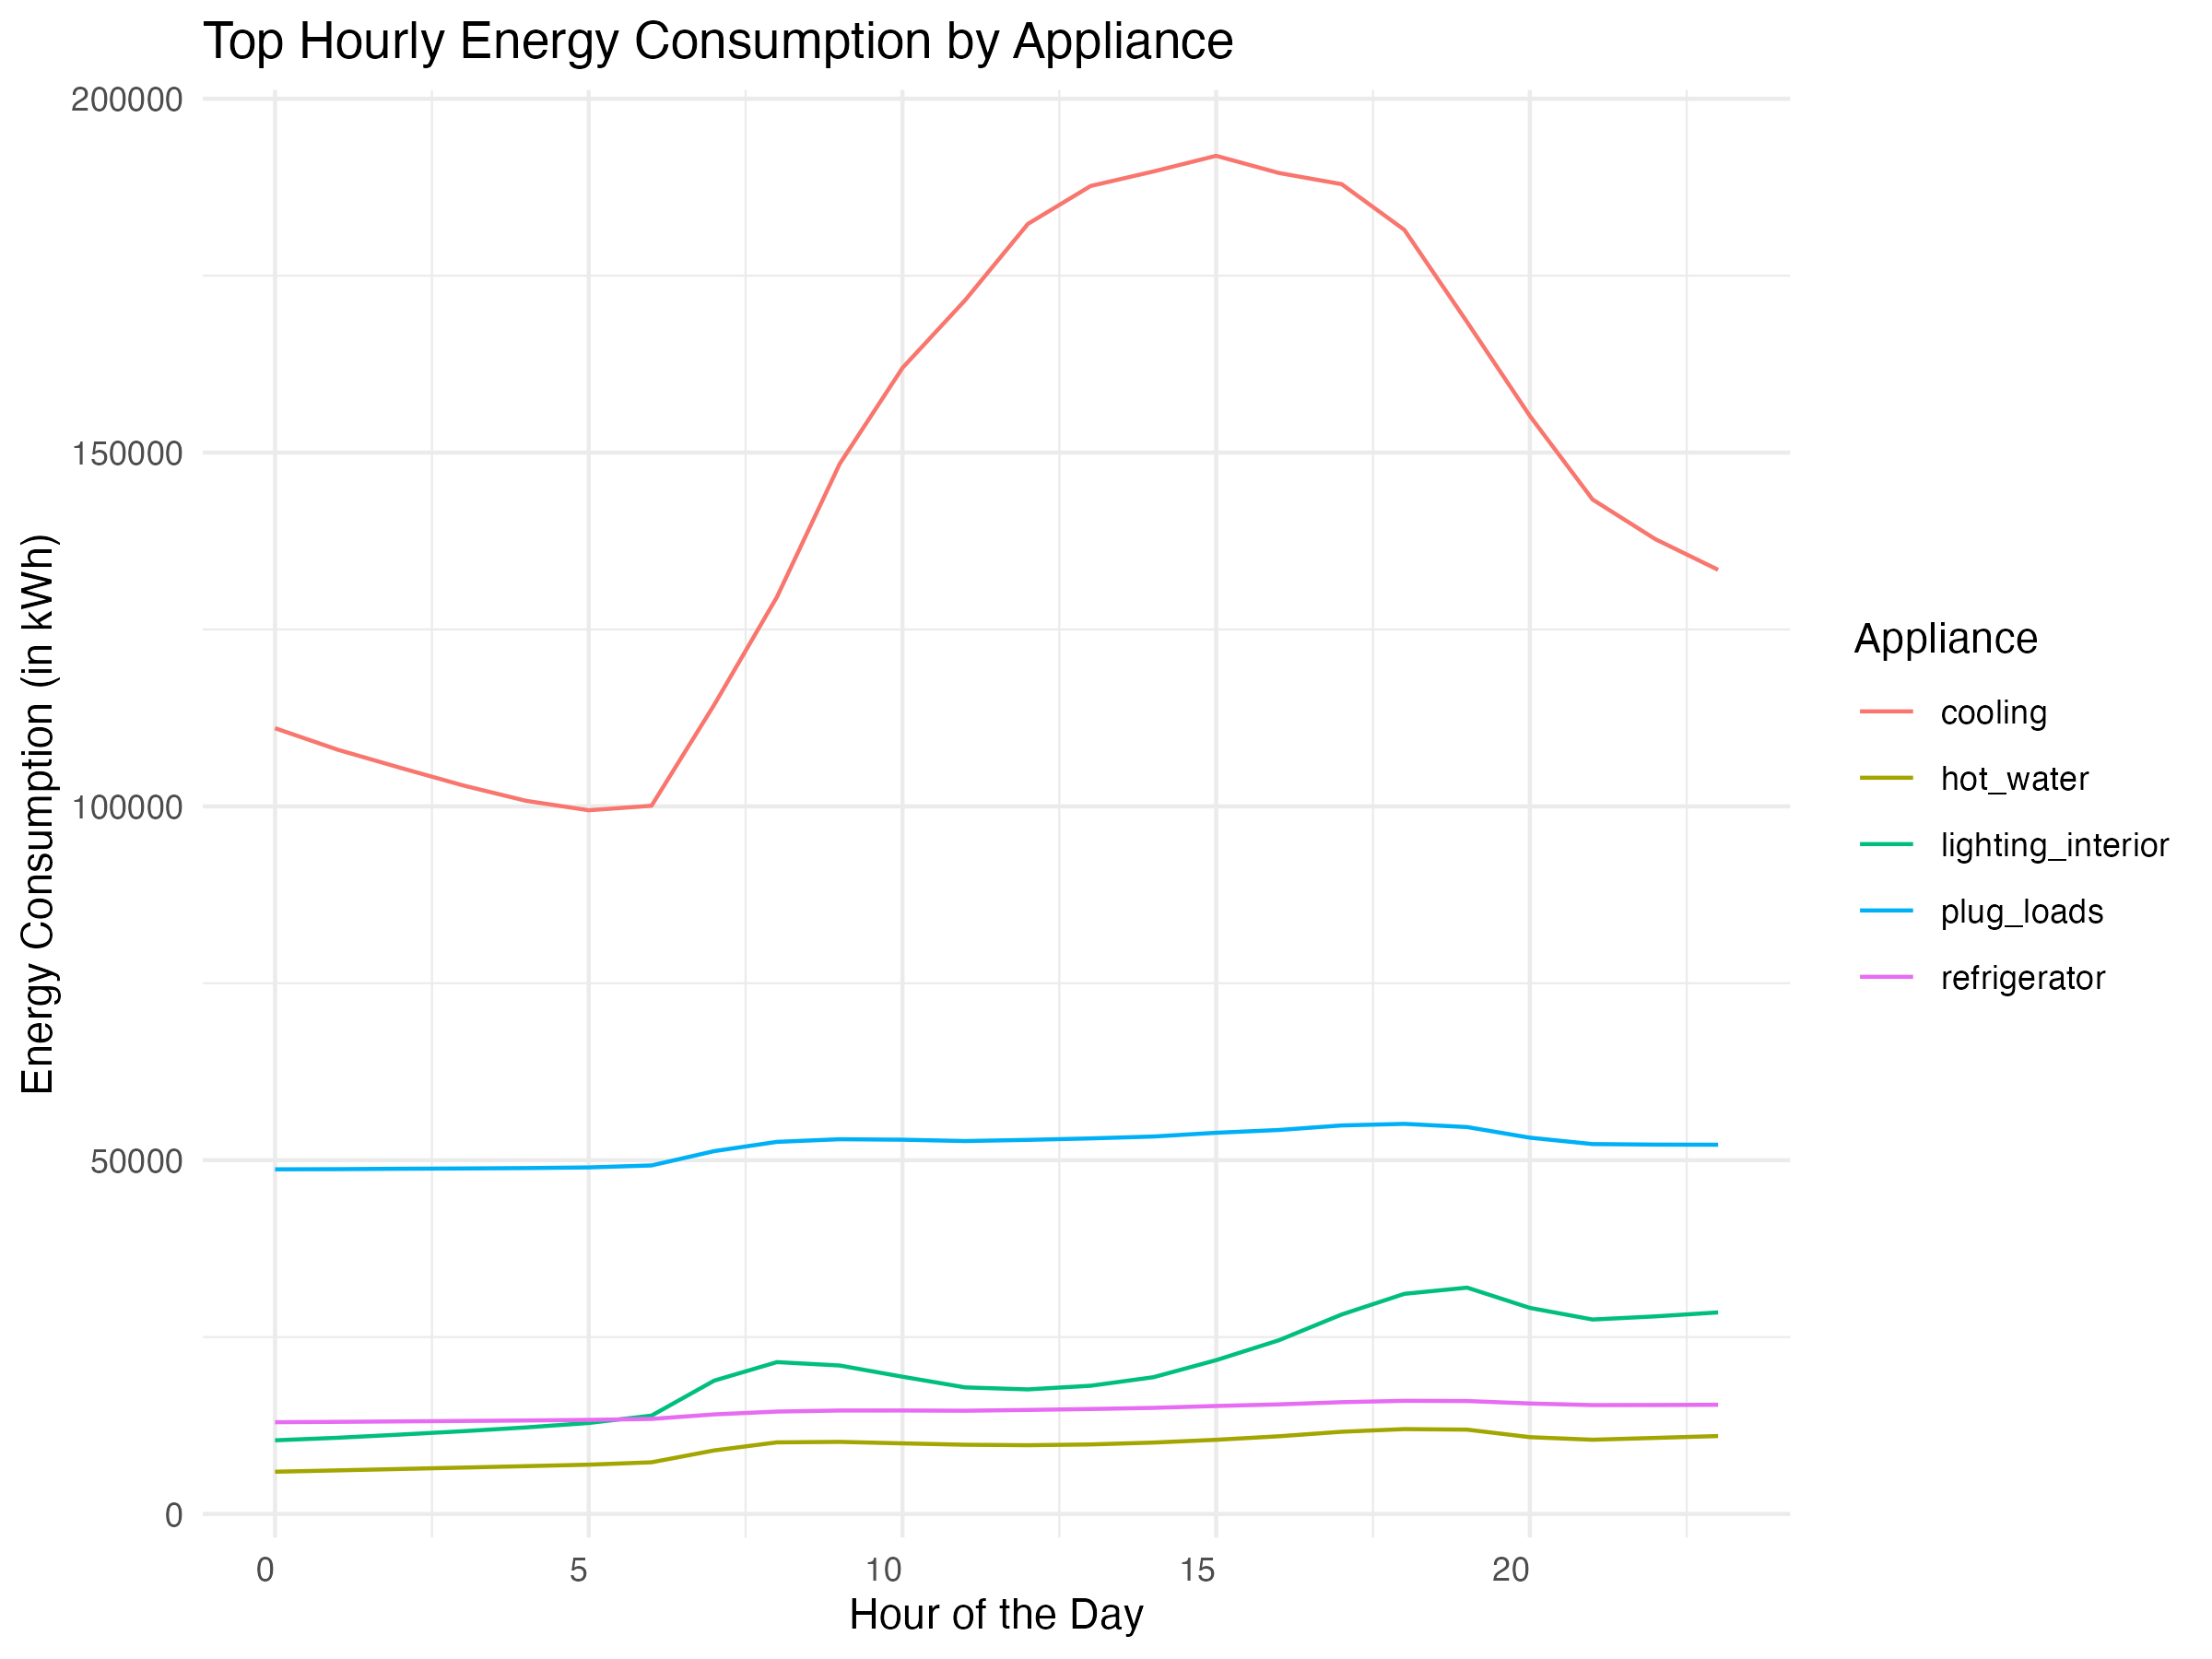
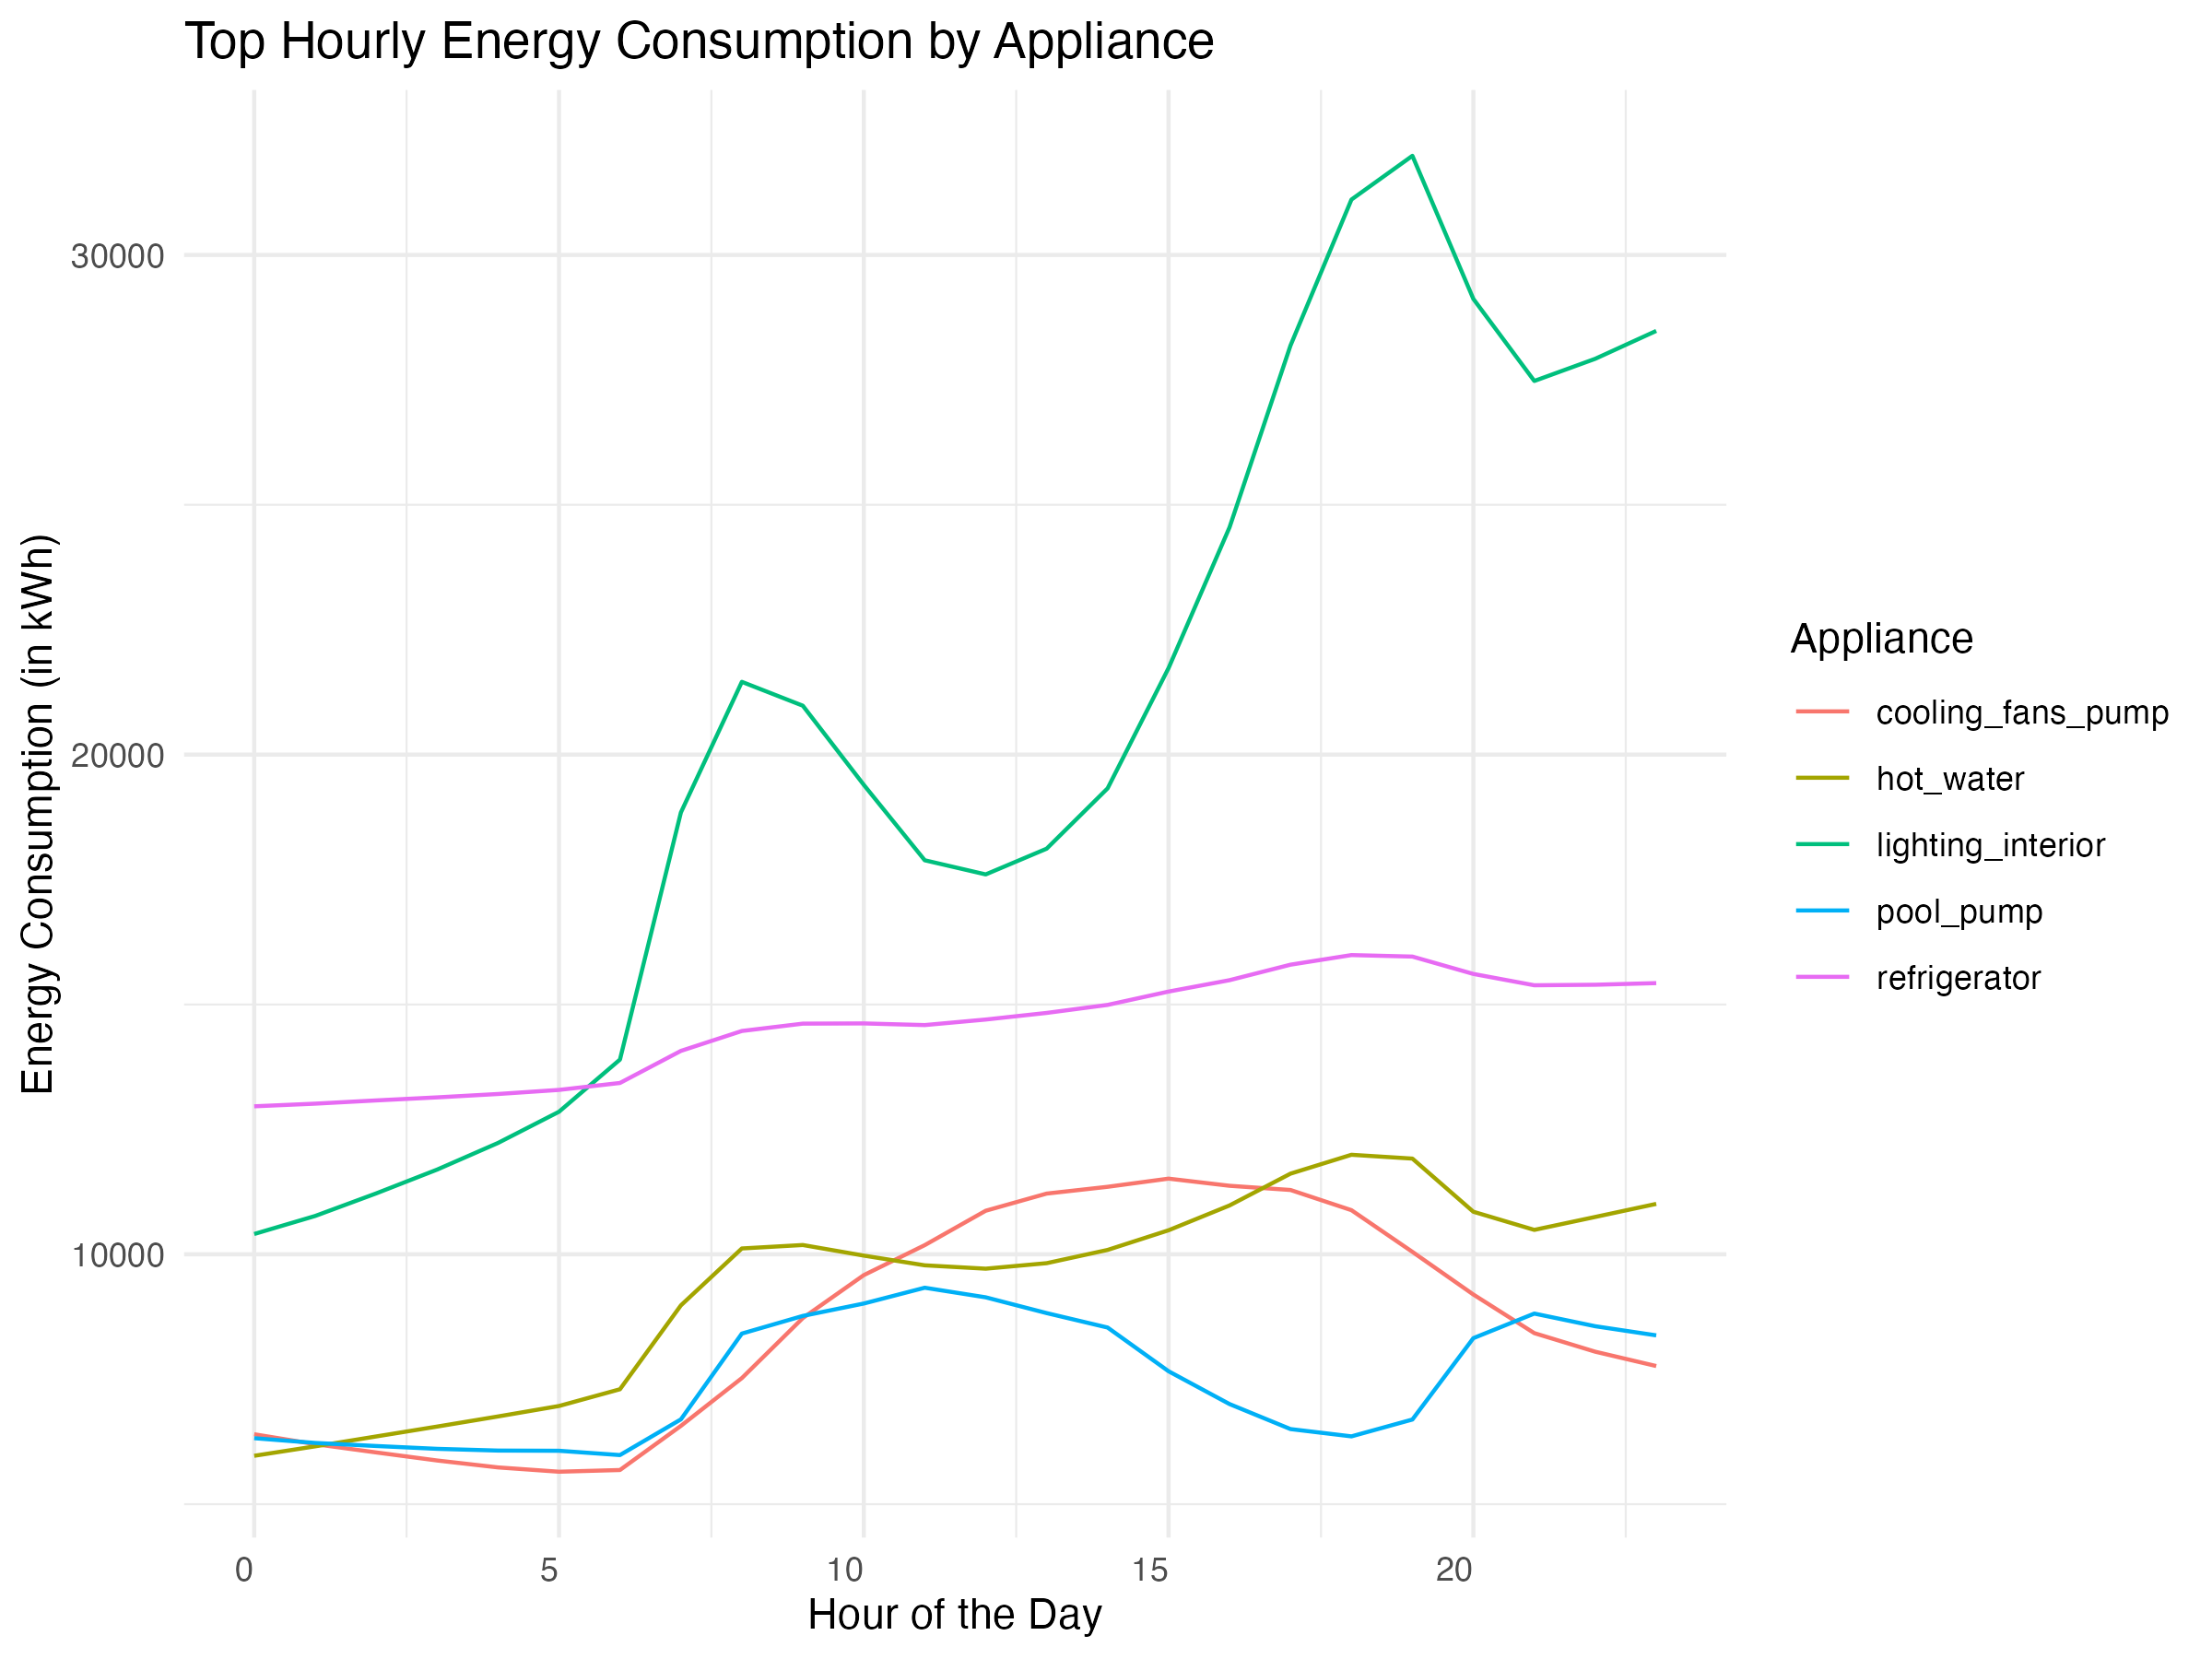
Forecasted Energy Usage by the Hour

Slide 6

Thank You
6
Eric Lee, Jade Matrone, Jeet Bardapurkar , Nithish Kumar, Sandeep Parmar

